Slide 1




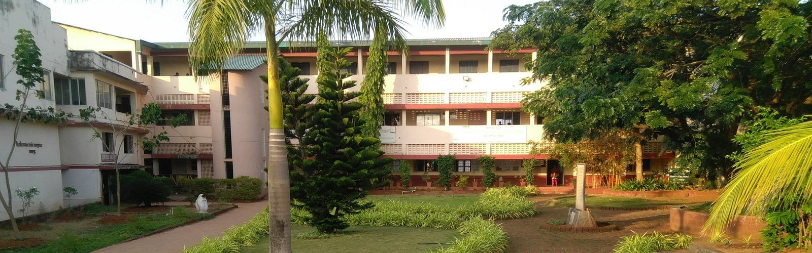

Shikshan Vikas Mandal’s Shri S. H. Kelkar College of Arts, Commerce and Science Devgad Best College Awarded by University of Mumbai.
News | Achievements | Press Media | Photo Gallery | NIRF | Alumni | Login | Feedback
+919422071492
dcdevgad@gmail.com
Home | About Us | Academic | NAAC | Library | Examination | Student | Facilities
Slide Show of latest news / achievements

Slide 2
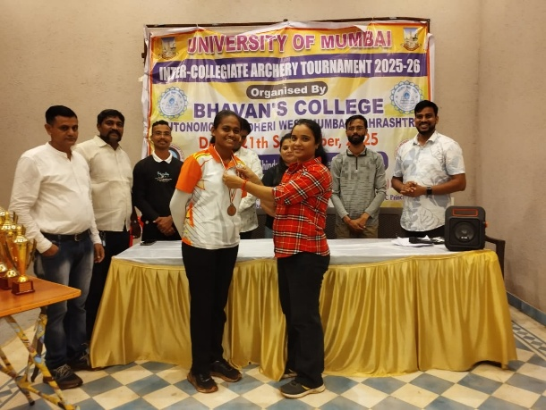

News | Achievements | Press Media | Photo Gallery | NIRF | Alumni | Login | Feedback
+919422071492
dcdevgad@gmail.com
Shikshan Vikas Mandal’s Shri S. H. Kelkar College of Arts, Commerce and Science Devgad Best College Awarded by University of Mumbai.
Home | About Us | Academic | NAAC | Library | Examination | Student | Facilities
News
Scrolling Latest Five Heading in Single Line i.e. Silver Medal in Archery
Events
Scrolling Latest Five Heading in Single Line i.e. Intercollegiate Football Tournament 18-19 November, 2025
Photos Slide Show
With Caption
Useful Links
Statuary Committees
Visitors
Contact Us
Postal Adress

Slide 3
News | Achievements | Press Media | Photo Gallery | NIRF | Alumni | Login | Feedback
+919422071492
dcdevgad@gmail.com
Shikshan Vikas Mandal’s Shri S. H. Kelkar College of Arts, Commerce and Science Devgad Best College Awarded by University of Mumbai.
Home | About Us | Academic | NAAC | Library | Examination | Student | Facilities
About College (History)
Vision and Mission
Chairman’s Message
Principal’s Desk
Vice-principal’s Desk
Management Council
College Development Cell
Administrative Staff
College Brief History

Slide 4
News | Achievements | Press Media | Photo Gallery | NIRF | Alumni | Login | Feedback
+919422071492
dcdevgad@gmail.com
Shikshan Vikas Mandal’s Shri S. H. Kelkar College of Arts, Commerce and Science Devgad Best College Awarded by University of Mumbai.
Home | About Us | Academic | NAAC | Library | Examination | Student | Facilities
Departments | Research
Arts
Commerce
Science
Management Studies
Banking and Insurance
Information Technology (IT)
Economics
English
Geography
History
Marathi
Rural Development
About Department
Program
Courses / Syllabus
Add on courses
Faculty
Facilities
Achievements
Gallery
Bachelor of Arts (B. A.)
Master of Arts
Admission Procedure Requirements Fee Structure Placements Alumni

Slide 5
News | Achievements | Press Media | Photo Gallery | NIRF | Alumni | Login | Feedback
+919422071492
dcdevgad@gmail.com
Shikshan Vikas Mandal’s Shri S. H. Kelkar College of Arts, Commerce and Science Devgad Best College Awarded by University of Mumbai.
Home | About Us | Academic | NAAC | Library | Examination | Student | Facilities
IQAC
IQAC Initiatives
AQAR
Self Study Reports (SSR)
Minutes of Meeting and ATR
MoU’s
Policies
Perspective Plane
Academic Calendar
IQAC Composition
Chairman
Co-Ordinator
Member- Management
Member- Faculty
Member
Member
Member
Member

Slide 6
News | Achievements | Press Media | Photo Gallery | NIRF | Alumni | Login | Feedback
+919422071492
dcdevgad@gmail.com
Shikshan Vikas Mandal’s Shri S. H. Kelkar College of Arts, Commerce and Science Devgad Best College Awarded by University of Mumbai.
Home | About Us | Academic | NAAC | Library | Examination | Student | Facilities
About Library
Librarian Desk
Reference Books
Periodicals
e-resources
Current Affairs
Librarian

Slide 7
News | Achievements | Press Media | Photo Gallery | NIRF | Alumni | Login | Feedback
+919422071492
dcdevgad@gmail.com
Shikshan Vikas Mandal’s Shri S. H. Kelkar College of Arts, Commerce and Science Devgad Best College Awarded by University of Mumbai.
Home | About Us | Academic | NAAC | Library | Examination | Student | Facilities
Admission | Co-curricular
Admission Procedure
Prospectus 2026-27
Code of Conduct
Quick Links
Anti Ragging Cell (ARC)
ICC
Attendance
Detaille Information

Slide 8
News | Achievements | Press Media | Photo Gallery | NIRF | Alumni | Login | Feedback
+919422071492
dcdevgad@gmail.com
Shikshan Vikas Mandal’s Shri S. H. Kelkar College of Arts, Commerce and Science Devgad Best College Awarded by University of Mumbai.
Home | About Us | Academic | NAAC | Library | Examination | Student | Facilities
Admission | Co-curricular
Career Katta
Cultural
DLLE
Gymkhana and Sports
NCC
NSS
Placement Cell
About Career Katta
Joining Procedure
Career Sansad
Career Katta Committee
Detaille Information

Slide 9
News | Achievements | Press Media | Photo Gallery | NIRF | Alumni | Login | Feedback
+919422071492
dcdevgad@gmail.com
Shikshan Vikas Mandal’s Shri S. H. Kelkar College of Arts, Commerce and Science Devgad Best College Awarded by University of Mumbai.
Home | About Us | Academic | NAAC | Library | Examination | Student | Facilities
Auditorium
Cafeteria
CCTV Surveillance
Girls Common Room
Gymkhana
Hostels
ICT enabled Classroom
Laboratories
Multifunctional Ground
Parking
Sick / Rest room
Detaille Information
About Gymkhana
Facilities
Code of Conduct
Gymkhana Committee
Gallery
Registration

Slide 10


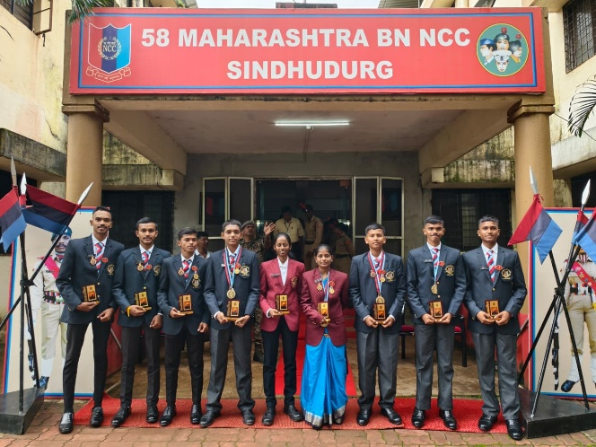
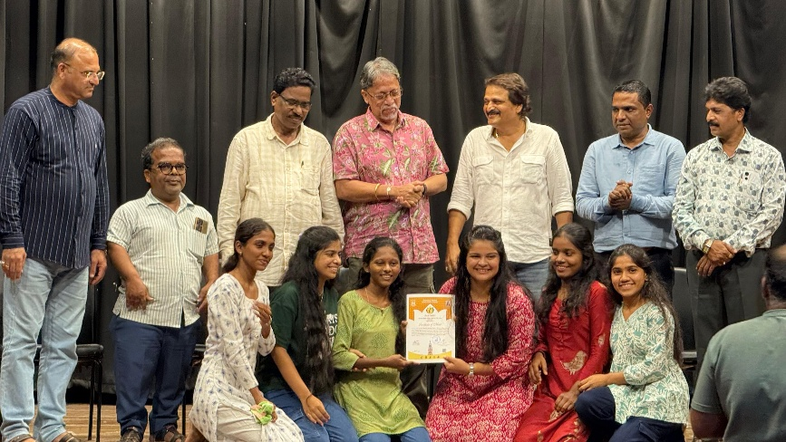
News | Achievements | Press Media | Gallery | NIRF | Alumni | Login | Feedback
+919422071492
dcdevgad@gmail.com
Shikshan Vikas Mandal’s Shri S. H. Kelkar College of Arts, Commerce and Science Devgad Best College Awarded by University of Mumbai.
Home | About Us | Academic | NAAC | Library | Student | Facilities | Gallery

